Slide 1
Sample Project Status/Schedule Summaries
In addition to managing a project plan in Microsoft Project, you may also wish to depict the schedule or project status in a more summarized version for Steering Committee meetings, team meetings, project kickoffs, weekly status reports, etc. These can be tailored to a specific project’s needs:
Sample 1: Executive View
Sample 2: Basic Status Dashboard A
Sample 3: Basic Status Dashboard B
Sample 4: Excel (Week by Week View)

Slide 2
Project Status Summary Sample 1
Key Milestones
Summary
Aug 2011
Sep 2011
Oct 2011
Nov 2011
Dec 2011
Jan 2012
Feb 2012
Mar 2012
Apr 2012
Project Description: TBD
Planned
1
2
3
4
5
6
Sept
25
Oct
20
Nov
29
Jan
29
Mar
15
Mar
30
Actual/Estimated
1
2
3
4
5
6
Sept
25
Nov
1
Dec
16
Mar
30
Apr
15
May
1
Kickoff Project
Project Phase - TBD
Project Phase - TBD
Project Phase - TBD
Project Phase - TBD
Deployment Date - TBD
Recent Accomplishments
TBD
TBD
TBD
Upcoming Key Activities
TBD
TBD
Scope:
TBD
TBD
TBD
Key Risks and Issues
TBD
TBD
Required Decisions & Guidance
TBD
TBD
2
Key Milestone Legend:
Gray
Originally planned or completed activity
Green
On track; will complete as planned
Yellow
Planned delivery at risk
Red
Will miss planned delivery

Slide 3
Project Status Summary Sample 2
Project Name: Current Phase:
Project Start: Planned/Revised End:
Baseline Budget: % Budget Spent:
Overall Project Status As of <Insert Date>:
Summary of Recent Status: TBD
Activities Completed:
  TBD
  TBD
  TBD
Activities In Progress:
  TBD
  TBD
  TBD
Issues/Risks:
  TBD
  TBD
  TBD
Key Deliverables/Milestones:
Deliverable | Owner/Signoff | Status | Planned/Revised Completion Date | Comments
3

Slide 4
Project Status Summary Sample 3
Overall Project Status As of <Insert Date>:
Activities Completed through <Insert Date> | Next Steps
Phase /Workstream TBD TBD TBD TBD Phase /Workstream TBD TBD TBD TBD | Phase /Workstream TBD TBD TBD TBD TBD Phase /Workstream TBD TBD TBD TBD
Risks/Key Decisions Required | Budget
TBD TBD | TBD TBD
4

Slide 5
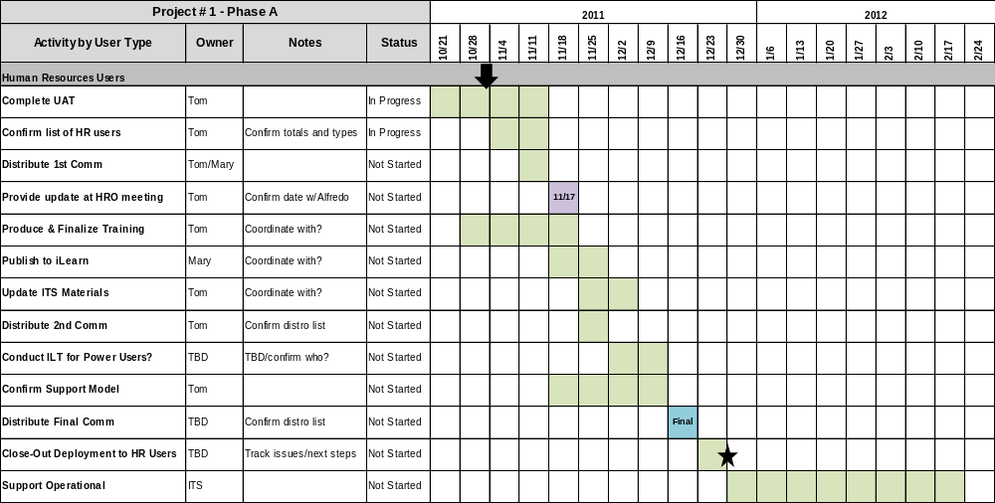
Project Status Summary Sample 4
5

